Slide 1
AUDI Q5 LED REFLEKTOR HB
Incoming Inspection Report
Incoming Inspection Performed by: Emmanuel Fernandez.
TOOL MAKER
Juárez , México
DATE: 02-11-2015

Slide 2
Tool General Information Identification Plaques.
Injection layout – Hot Runner System ,Plaques, tests .
Layout Cavity Side (Main appearances ).
Slides , Retractors , Lifters Details.
Layout Core Side (Main appearances ) .
Ejector System & Parts .
Locating Ring.
Electrical Plugs .
Water Leaks Test.
Spare Parts , Documents ,Tool manuals etc. Received .
Observations / Summary.
Quick Check List.

Slide 3
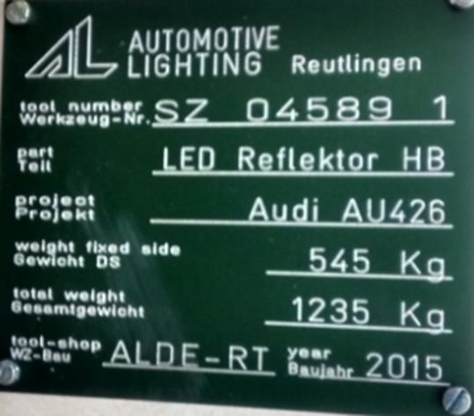
Tool Identification plate
✓
IDENTIFICATION
Tool Source : ALDE-RT
Job : SZ 04589 1
Part Number: 6002TC0645/6002TC0646
BACK TO INDEX

Slide 4
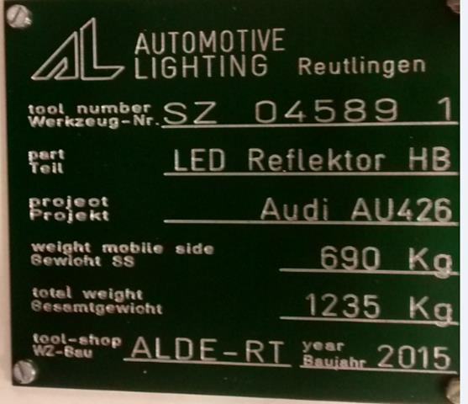
General Information
✓
Owner of Tool: Audi
MOLD WEIGHT: 1,235 kg.
MOLD SIZE (axbxc): 1180 mm X 835 mm X
845 mm
BACK TO INDEX

Slide 5
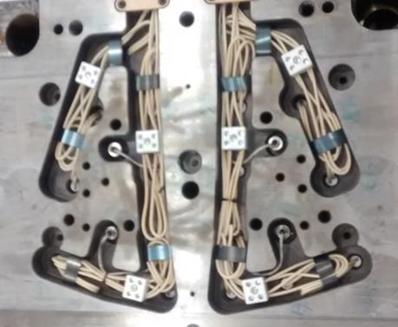
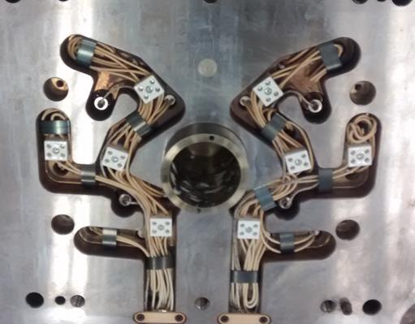
Hot Runner System
✓
The mold not have HRS due is cold runner
BACK TO INDEX

Slide 6
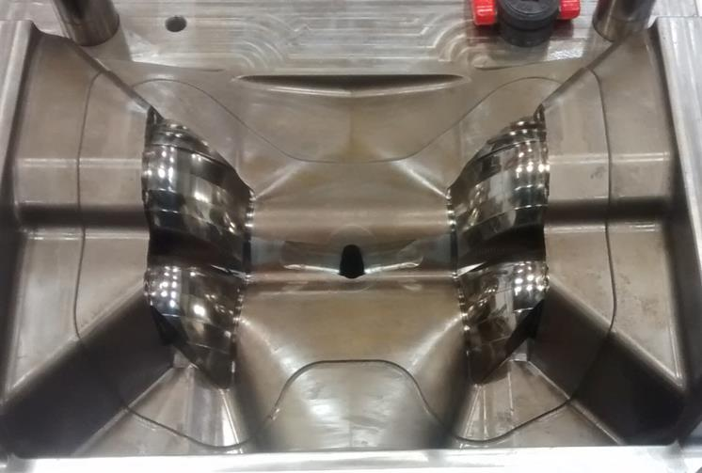
Lay outs – Cavity Side
Mold Cavity – How many Cavity ?
✓
The mold have 2 cavities (RH/LH)
BACK TO INDEX

Slide 7
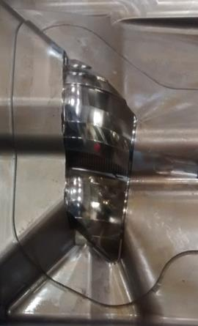
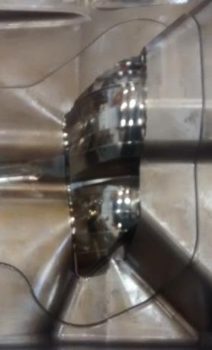
Lay out – cavity LH & RH
✓
CAVITY RH
CAVITY LH
Frontal View cavities RH & LH. Comments:
No damages founded!
BACK TO INDEX

Slide 8
Slides, Retractors , Lifters etc.
✓
The mold not have slides and retractors
 |  |  | COMMENTS
NO. OF SLIDES
DAMAGES |  |  | NO VISIVLE DAMAGRES
WATER LEAKS |  |  | NOT HAVE WATER CIRCUIT
PLUGS - PRESS FIT OR THREADED
STOPPER
WATER CONNECTOR SIZE
MOVEMENTS |  |  | N/A
CAM PIN POSITION |  |  | N/A
SLIDE RETAINER |  |  | N/A
BACK TO INDEX

Slide 9
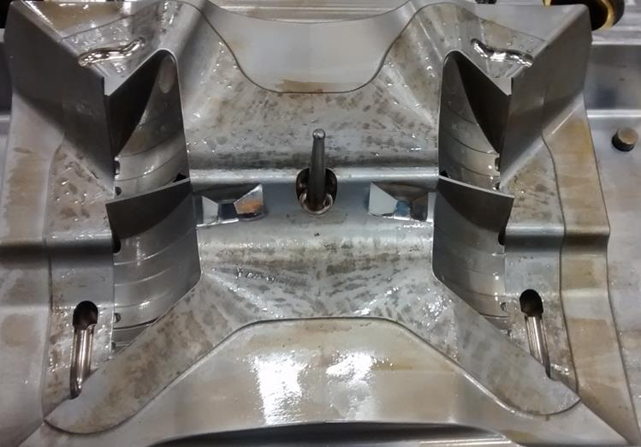
Core Layout
✓
Frontal View cores LH& RH, comments:
No visible Damage founded
BACK TO INDEX

Slide 10
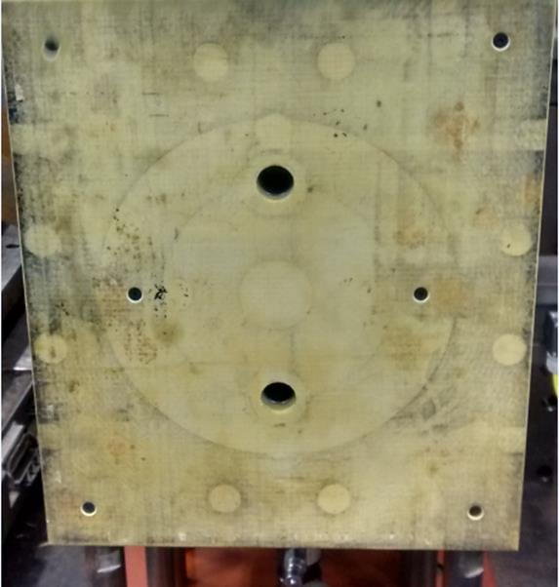
Ejector System
✓
5/8 - 11
8 IN
BACK TO INDEX

Slide 11
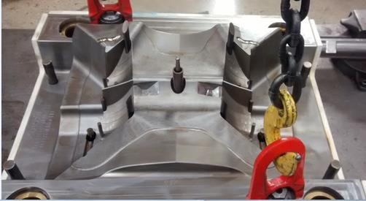
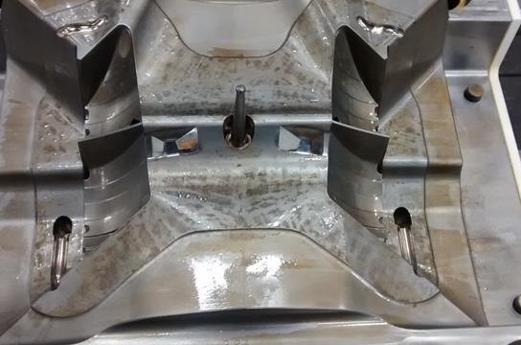
Ejector System
✓
Ejector system backward position picture
Ejector system forward position picture
Ejector System Tested ? , Back and Forward Position ?
The Ejector System Is Ok!
BACK TO INDEX

Slide 12
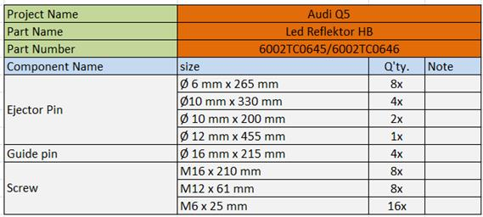
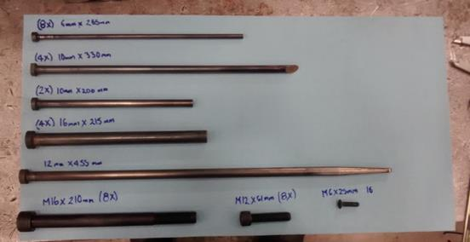
Ejector system parts and components
✓
BACK TO INDEX

Slide 13
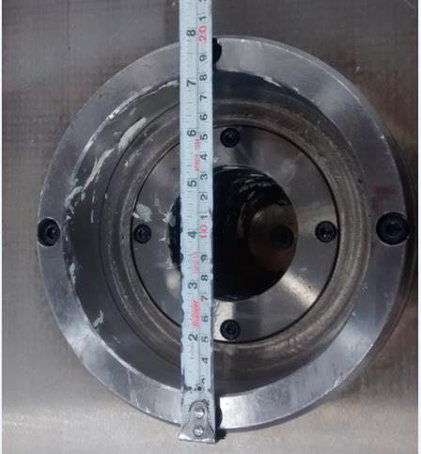
Locator Ring
✓
How many Locating rings ?
1
Sizes?
200 mm
BACK TO INDEX

Slide 14
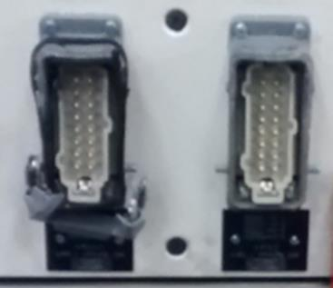
Electrical Parts
✓
Conector Plug .
Conector standard D-M-E per Heater and Thermocouples ?
12 for zones
heaters and thermocouple.
BACK TO INDEX

Slide 15
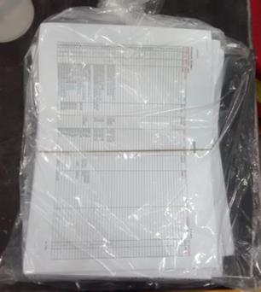
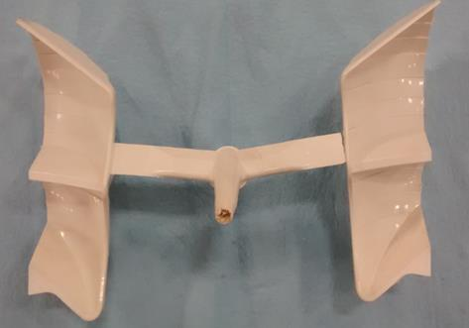
Spare parts ,Documents , Tool Manual etc. Received
✓
the mold arrived with Tool Books and pieces molded
BACK TO INDEX

Slide 16
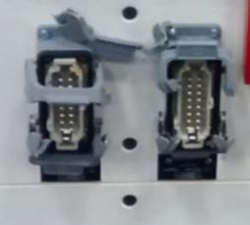
Observations
✓
In the incoming inspection not detected failures
The ejector system is working Ok.
The mold arrived with damages in conectors of resistors.
BACK TO INDEX

Slide 17
Quick Checklist
L# | DESCRIPTION | YES | NO | N/A | COMMENTS / OBSERVATIONS
1 | LOCATING RINGS | ✓ |  |  | How many numbers? 1
2 | AIR VENTS & ITS DEPTH | ✓ |  |  | Availability of sufficient number of air vents? YES
3 | INTERLOCKS ( PARTING LINE LOCKS ) |  |  |  | How many? 2
4 | DATE INSERTS OR ENGRAVING |  | ✓ |  | Specify how many years?
5 | HOT RUNNER SYSTEMS NUMBER |  |  |  | is cold runner
6 | THERMOCOUPLE & RESISTANCE SPARES | ✓
7 | EJECTOR BLADES |  |  | ✓
8 | VALVE GATES AVAILABILITY | ✓
9 | ANGLE PINS FOR SLIDES |  |  | ✓
10 | LOCKING CYLINDERS AVAILABILITY |  |  | ✓
11 | SPRINGS ON EJECTION SYSTEM |  |  | ✓
12 | TEXTURES IN CAVITY |  | ✓
13 | IDENTIFICATION ON ALL PARTS | ✓
14 | HYDRAULIC PISTON FOR CORES | ✓
15 | LIMIT SWITCHES (MICRO SWITCH) | ✓
16 | RJG OR SPECIAL SENSORS |  | ✓ |  | Specify ?
17 | SAFETY LOCK
18 | INSERT CHANGES SPARES | ✓
19 | MOLD DRAWINGS & CD | ✓
BACK TO INDEX

Slide 18
Quick Checklist
MOLD NUMBER | SZ 04589 1
PART NUMBER | 6002TC0645/6002TC0646
PART NAME | LED REFLEKTOR HB
NO. OF CAVITIES | 2
CAVITIES MARKED NO.'S | L/R
TOOLING ENGINEER NAME | Francisco Melendez
MOLD ARRIVAL DATE | 11/16/15
MOLD INCOMING INSP. DATE | 11/17/15
FREQUENCY FOR PM | N/A
PRESS ASSIGNED | N/A
BACK TO INDEX

